Slide 1
Session 0 - Introductions all round

Slide 2
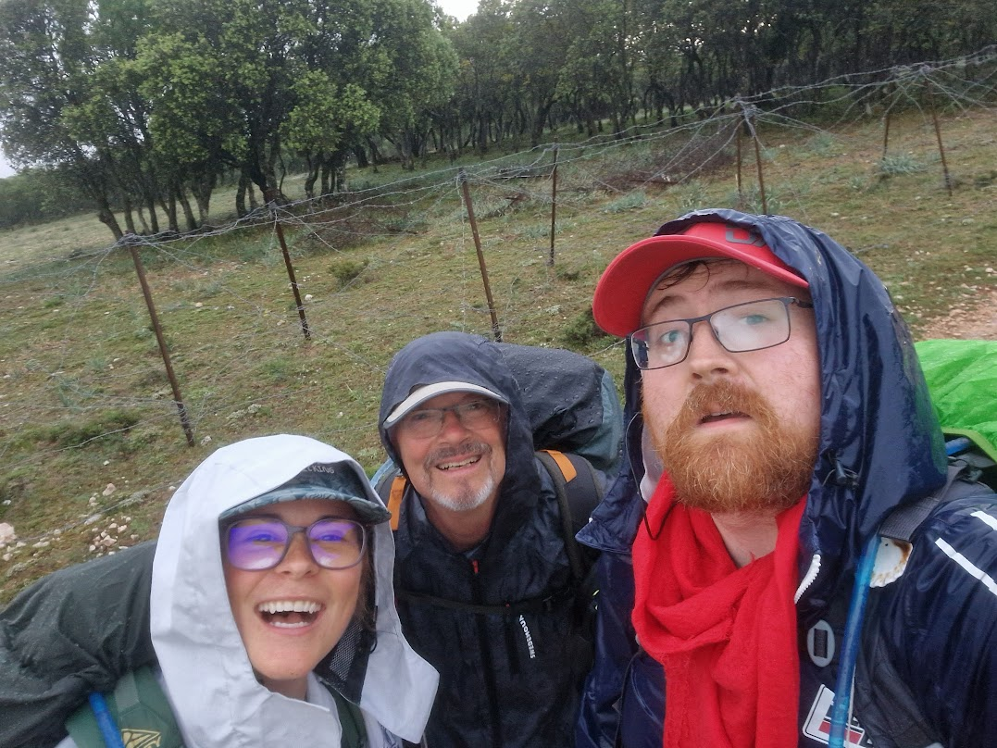
Welcome!
Welcome to the first session of this summer school!
My name is Kev O Malley, and I’m the nerd who’ll be accompanying you through this material, but it should be noted that this content is building on some other really amazing work by some really amazing people, and I’ll be sure to give them credit as we go along, but just to note that this material is heavily inspired by:
The python crash course (Matthes 2022)
Pandas for everyone (Chen 2017)
There’s a second edition of this, I haven’t read it, but I’m sure it’s great!
Harvard’s CS50 (Malan 2020)
This is free online and it’s genuinely excellent, they also have intros to python and r which will go deeper than this course.
A deep and abiding hatred of SPSS and MS Word (excel is great though, don’t @ me)

Slide 3
In this session, we’re going to:
Give you an overview of the course:
What we’re going to be doing (learning together).
Why we’re doing it (to empower each other).
What you can expect to get out of it (a sense of agency and efficacy).
Introduce you to the tools we’re going to be using (and mention some of the alternatives).
Quarto (as a tool for writing documents, reports, and papers).
Python (as a tool for doing data analysis and visualisation).
R (as an alternative to Python for doing data analysis and visualisation).
Git (as a tool for collaboration, managing your documents and code)
Accompany you through the process of producing your first documents using these tools.

Slide 4

But first…
Let’s address the elephant in the room.
When you think of people who work with computer programming, you may think of people that look like this…

Slide 5
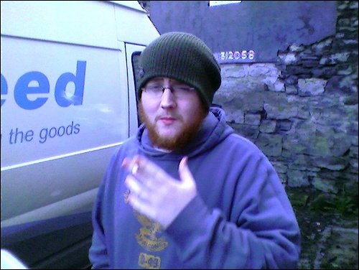
Or maybe like this

Slide 6
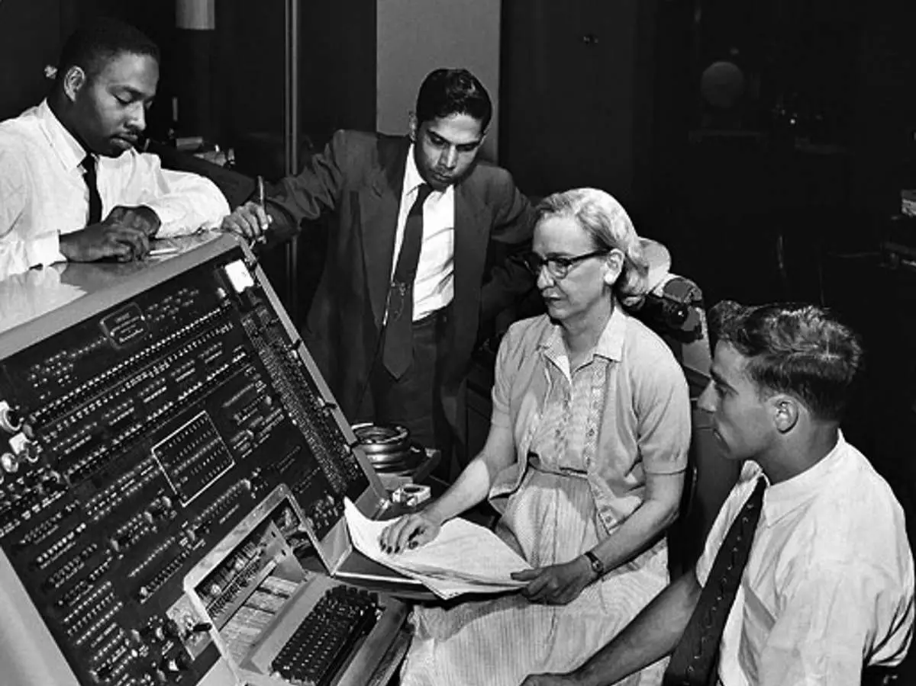
But in reality…
These tools were developed by, and are used by, people from all walks of life
AND ALWAYS HAVE BEEN

Slide 7
So here’s a couple of quotes that inspired these materials
‘The Great Being saith: Regard [humanity] as a mine rich in gems of inestimable value. Education can, alone, cause it to reveal its treasures, and enable mankind to benefit therefrom.’ (Baha’u’llah 19th century)
“We are what we repeatedly do. Excellence, therefore, is not an act, but a habit.” (Durant 1933, paraphrasing Aristotle)

Slide 8
Links
Quarto
VS code quarto overview

Slide 9
References
Baha’u’llah. 19th century. “Tablet of Baha’u’llah: Lawh-i-Maqsud.” Manuscript. https://www.bahai.org/library/authoritative-texts/bahaullah/tablets-bahaullah/5#722342929.
Chen, D. Y. 2017. Pandas for Everyone: Python Data Analysis. Addison-Wesley Data & Analytics Series. Pearson Education. https://books.google.ie/books?id=7zhDDwAAQBAJ.
Durant, W. 1933. The Story of Philosophy. https://books.google.ie/books?id=IAk7zgEACAAJ.
Malan, David. 2020. “CS50 2020 - Lecture 0 - Scratch.” YouTube. September 1, 2020. https://www.youtube.com/watch?v=YoXxevp1WRQ.
Matthes, Eric. 2022. Python Crash Course. 3rd ed. No Starch Press.

